Slide 1

Presentation on Frontend Project (CS186) Project Name: Recipe Finder
Submitted By: Ankit Mishra Submitted To:
Roll-No. : 2110991966
Group: G-19
Department of Computer Science & Engineering Chitkara University Institute of Engineering & Technology, Rajpura, Punjab.

Slide 2

Recipe Finder
Introduction: The Recipe Finder Frontend Project is an exciting web application designed to help users discover, explore, and organize a wide variety of recipes. This project aims to make your cooking experience more enjoyable and convenient.
In this project, the frontend component is the user-facing interface of the Recipe Finder application.
The frontend is typically built using web technologies, such as HTML, CSS, and JavaScript, along with various web development frameworks and libraries.

Slide 3
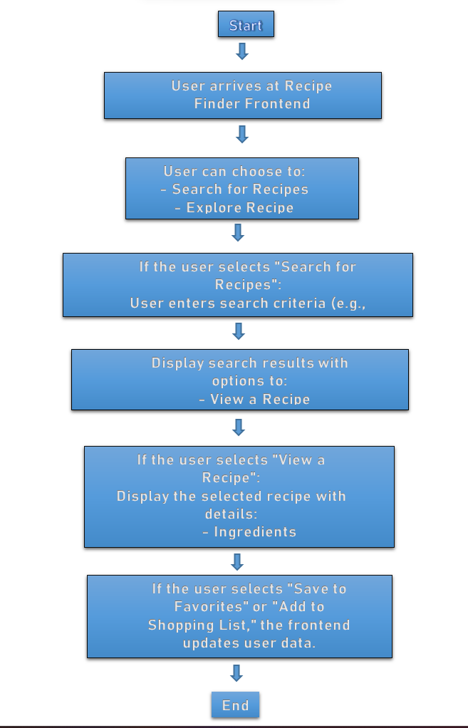
Flow Chart

Slide 4
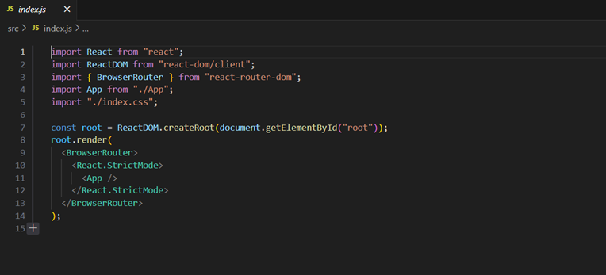
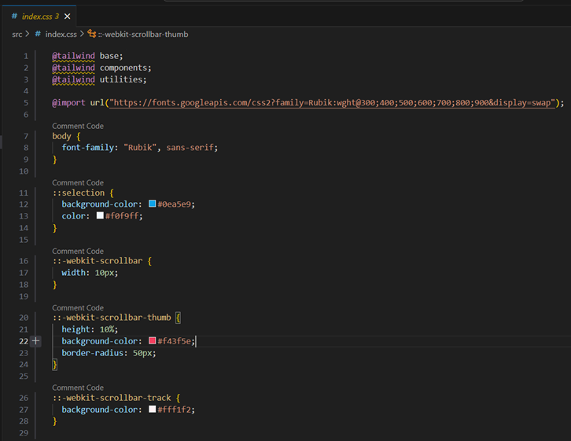

Slide 5
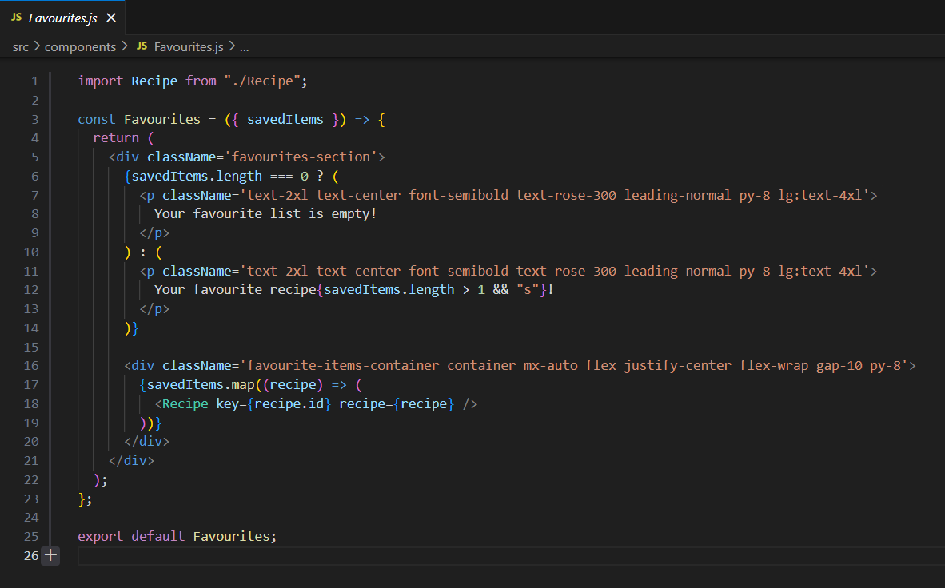

Slide 6
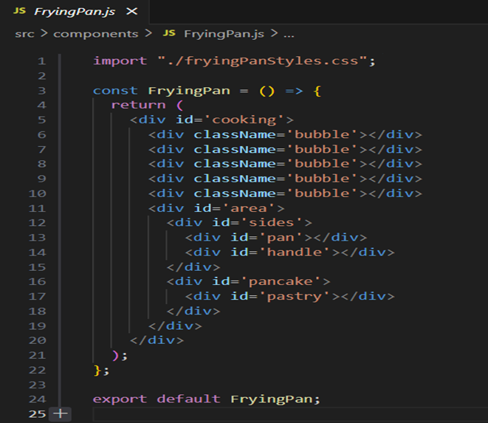
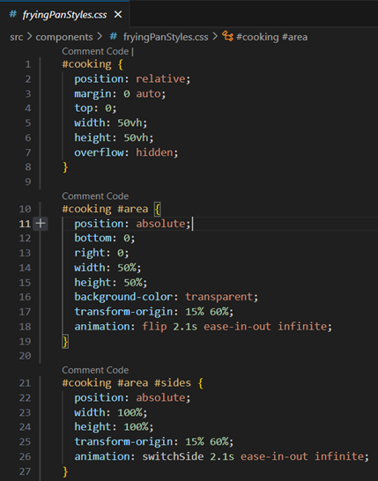
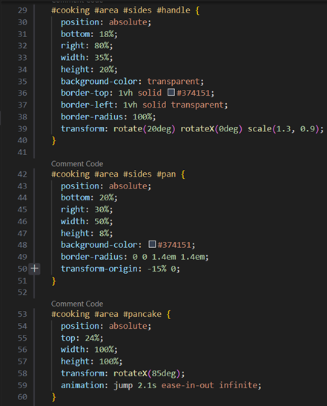
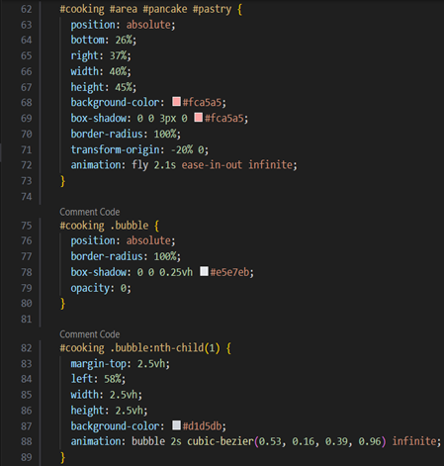
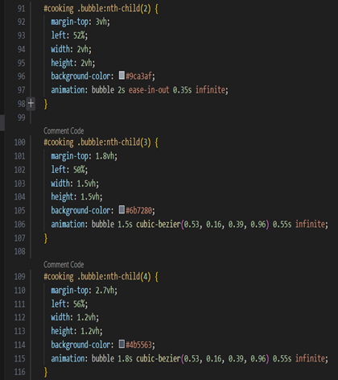

Slide 7
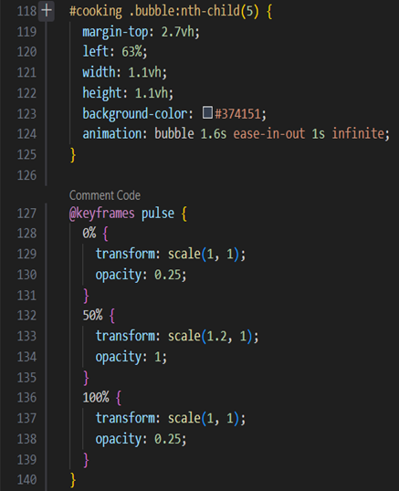
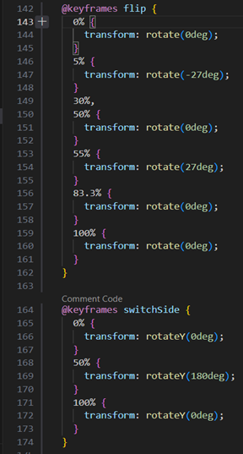
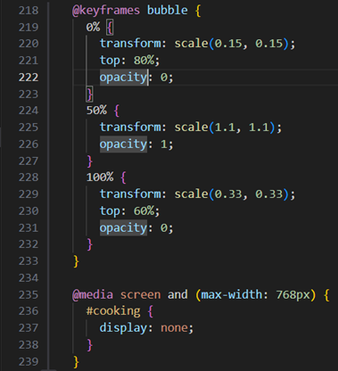
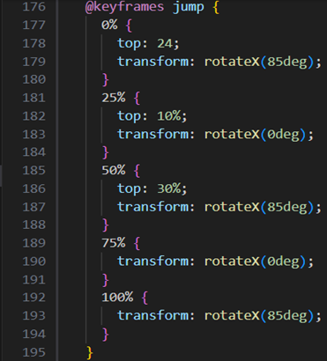
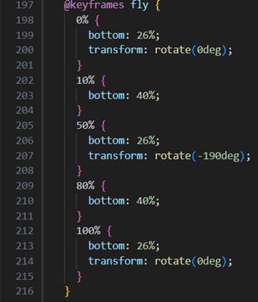

Slide 8
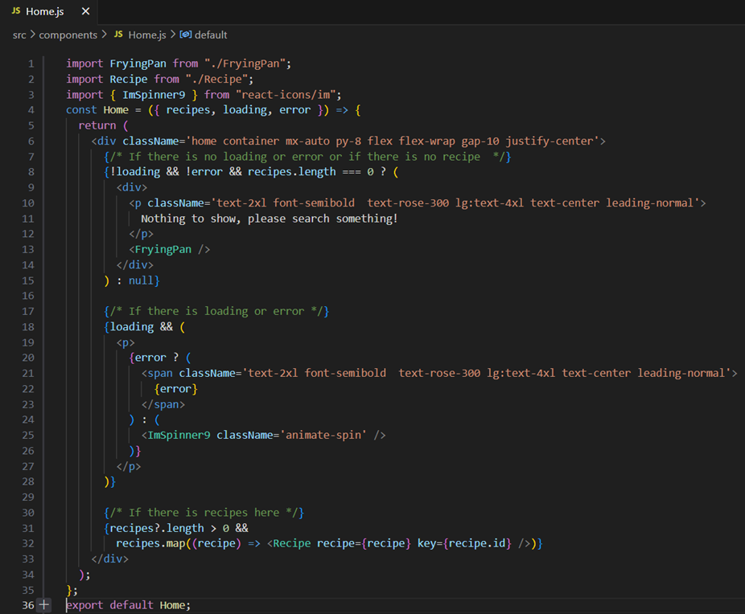

Slide 9
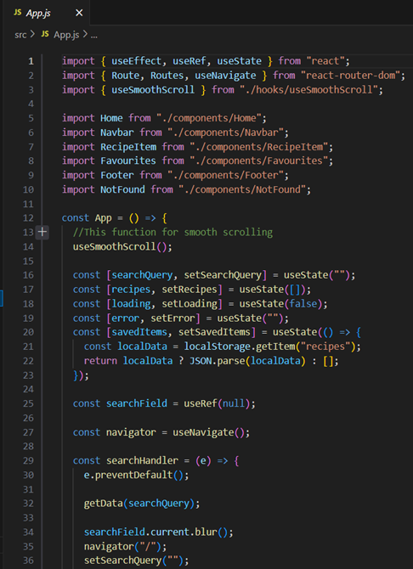
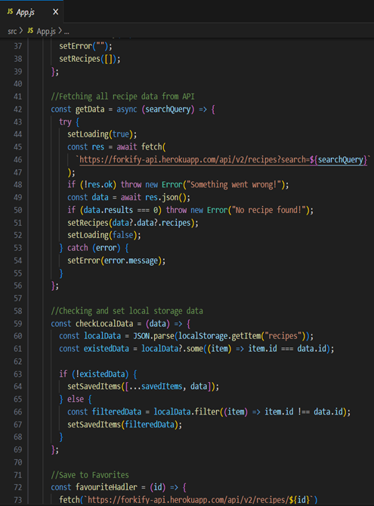
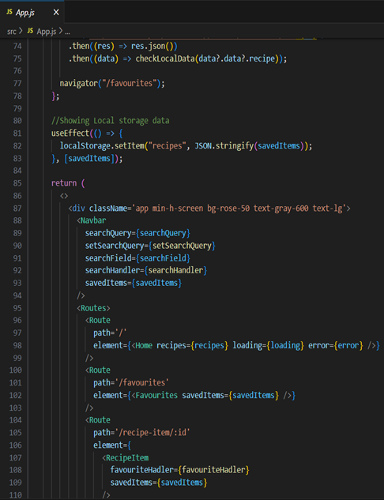
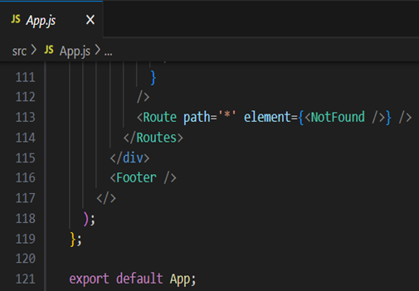

Slide 10
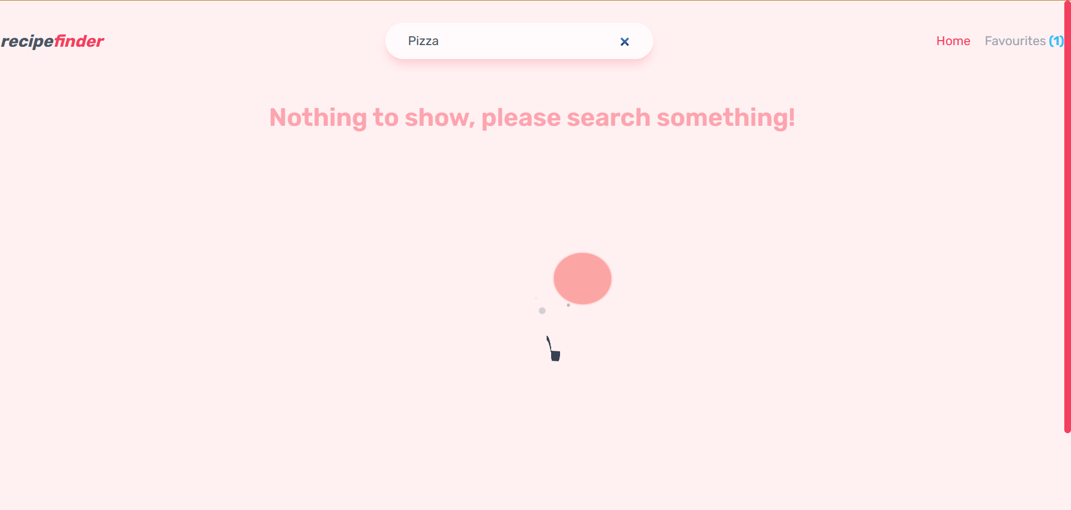

Slide 11
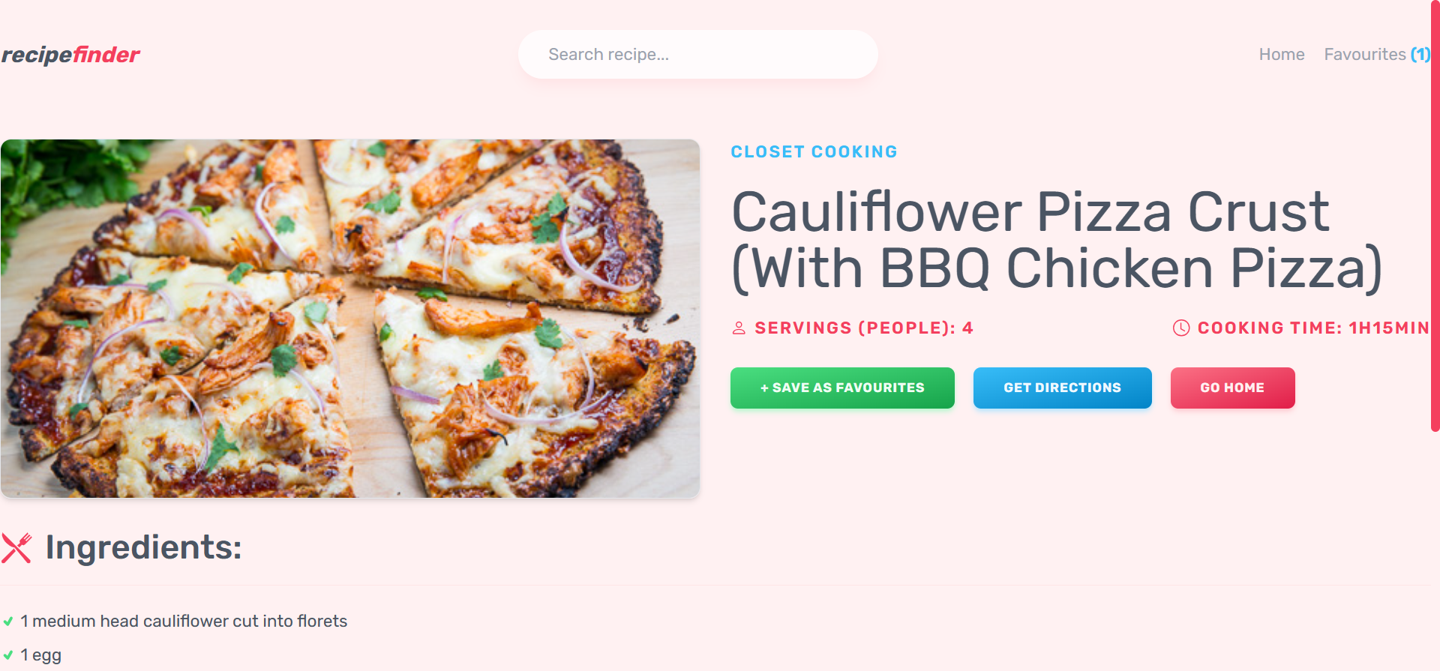

Slide 12
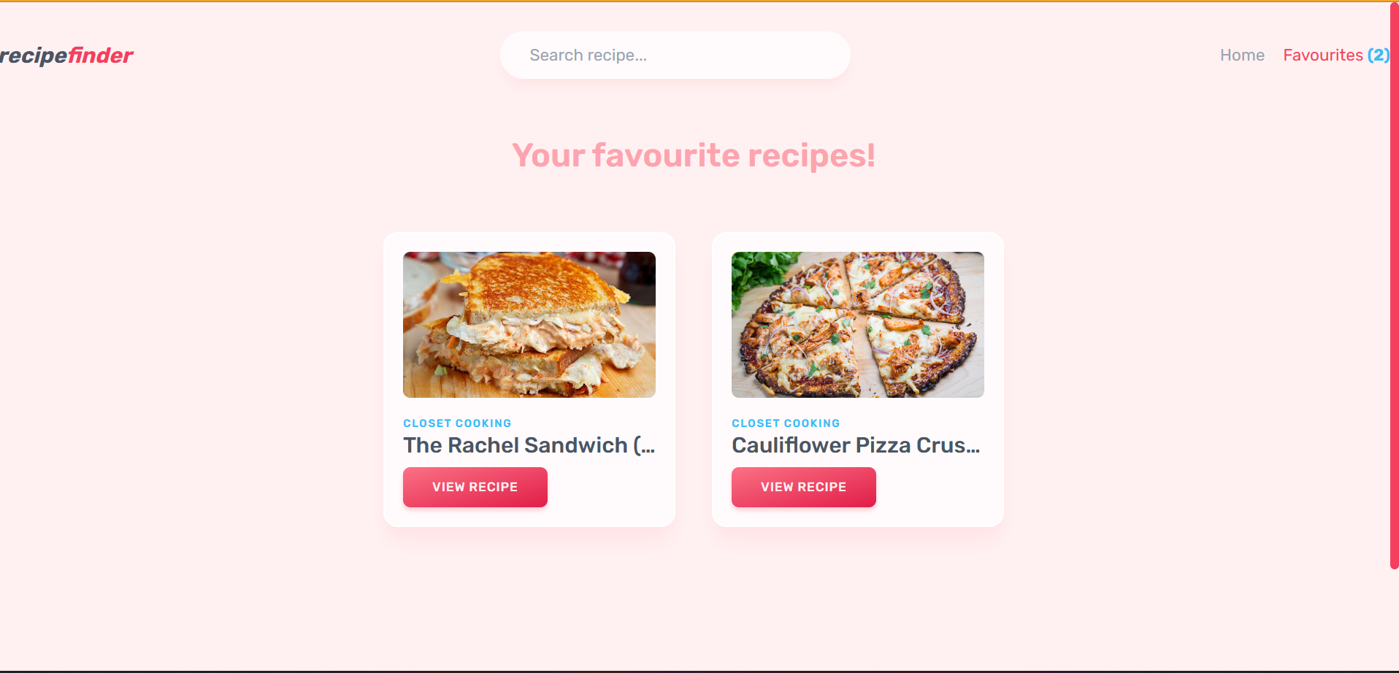

Slide 13
THANK YOU

